Slide 1
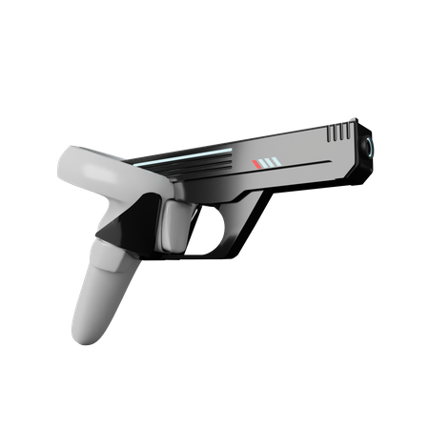
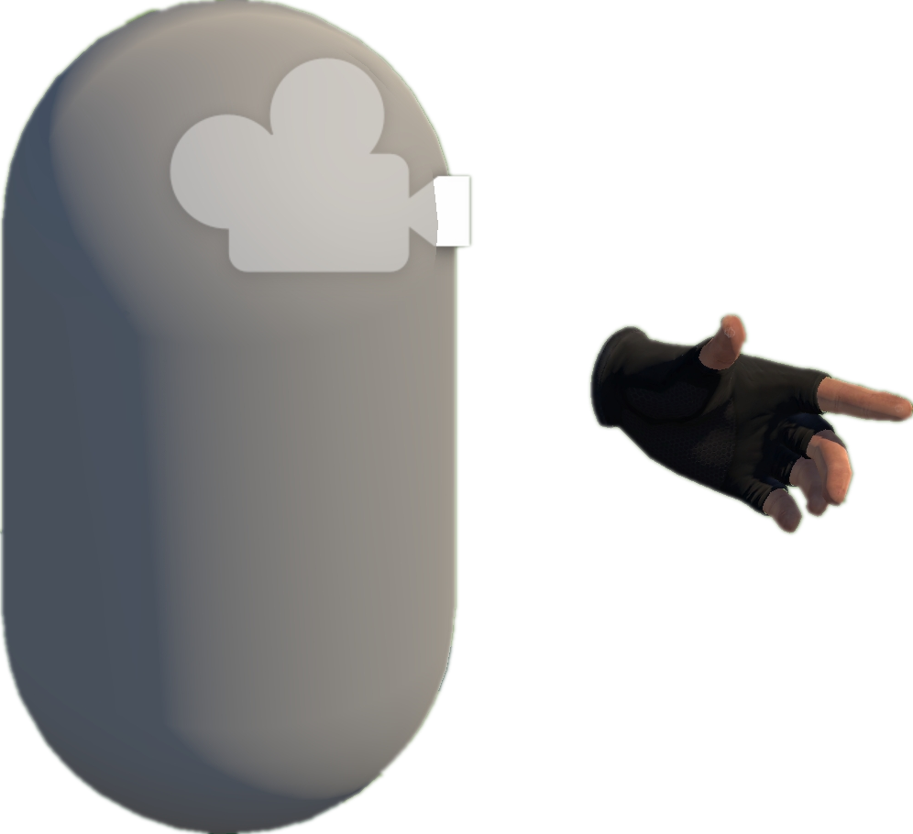
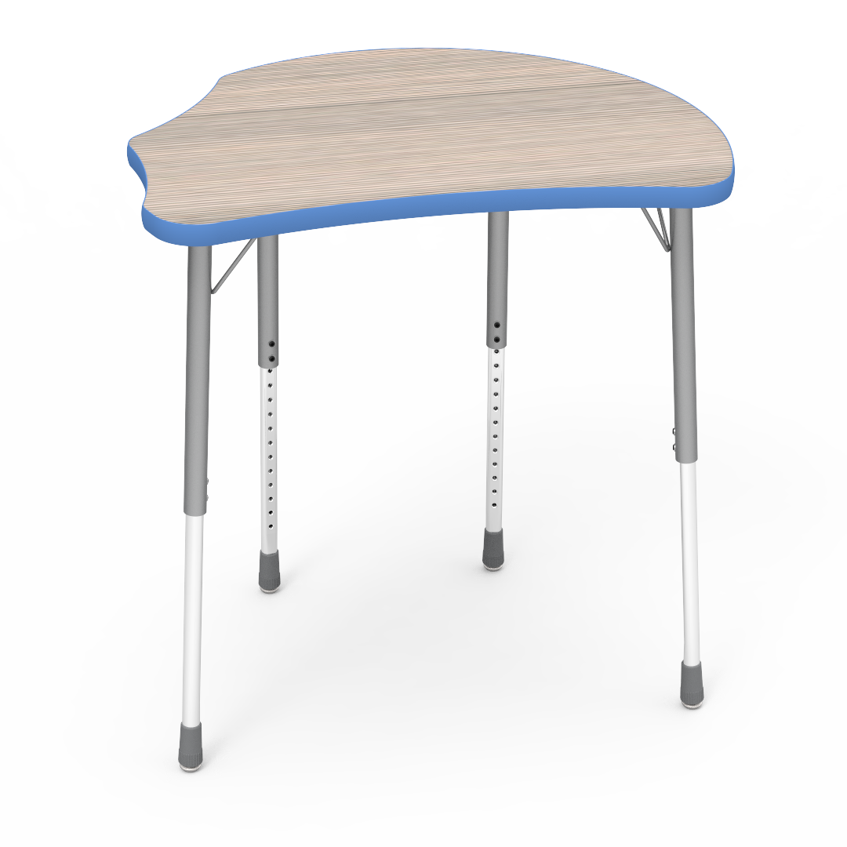
1
Move to Approcach The Gun
2
Try to Grab the Gun
3
Move Around Randomly;
Try to Fire the Gun

